Slide 1
Static Single-Assignment Value numbering
Presenter: Nguyen Khac Thai
Advanced Compiler Topic

Slide 2
Content
Static Single-Assignment
Introduction
Benefits
Normal form to SSA form conversion
Value Numbering
Introduction
Value numbering on SSA

Slide 3
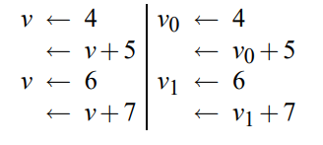
Static Single-Assignment
Static Single-Assignment
Each variable is assigned exactly once
But may be used multiple times
Multiple assignments => create new versions of that variable
Normal vs SSA

Slide 4
Static Single-Assignment
Benefits
Make use-def chains explicit
Simplify many optimizations process
Constant propagation
Value range propagation
Sparse conditional constant propagation
Dead code elimination
Global value numbering
Partial redundancy elimination
….
Used in most commercial compilers or VMs these days
including LLVM

Slide 5
Static Single-Assignment
Benefits
Example: Instruction scheduling
Assume it is advantageous to swap s2 and s3
With SSA, the analysis for scheduling is more simple
s1: a = 5;
s2: b = f(a);
s3: a = 6;
s4: c = f(a);
s1: a1 = 5;
s2: b = f(a1);
s3: a2 = 6;
s4: c = f(a2);

Slide 6


Static Single-Assignment
Conversion to SSA form
No control flow, it’s easy
$$a←x+y \\ b←a−1 \\ a←y+b \\ b←x∙4 \\ a←a+b$$
$$a_{1}←x+y \\ b_{1}←a_{1}−1 \\ a_{2}←y+b_{2} \\ b_{2}←x∙4 \\ a_{3}←a_{2}+b_{3}$$

Slide 7
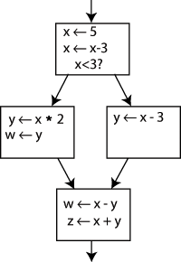
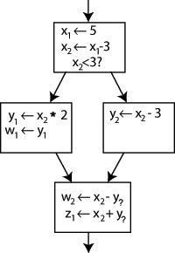
Static Single-Assignment
Conversion to SSA form
With control flow, which variable to use at join point?

Slide 8
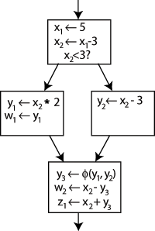
Static Single-Assignment
Conversion to SSA form
With control flow, which variable to use at join point?
Insert φ-function
Not ordinary function
Return value depends on control path

Slide 9
Value Numbering
Value numbering
Determining when two computations are congruent
Eliminate one of them with semantics-preserving transformation
Usually discover facts that constant propagation and redundancy elimination also does
However, they are generally incomparable
w := 3
x := 3
y := x + 4
z := w + 4
Read A
B := A + 2
C := A
D := C + 2
Value Numbering should discover
- w and x are congruent
- y and z are congruent
constant propagation and
redundancy elimination missed this case

Slide 10
Value Numbering
Partitioning variables into congruence classes
Variables in a congruence class have same value
Same functions with same arguments have same values?
This does not hold for φ-function
φ-function are subscripted with corresponding join point to keep this assumption
Algorithms
Pessimistic value numbering
Optimistic value numbering

Slide 11
Value Numbering
Pessimistic value numbering
starts from the assumption that no variables are congruent
is faster in terms of time complexity

Slide 12
Value Numbering
Optimistic value numbering
starts from assumption that all variables with the same operators are in the same congruence class
Maintain a worklist for determining the split order
has better result for programs with loops

Slide 13
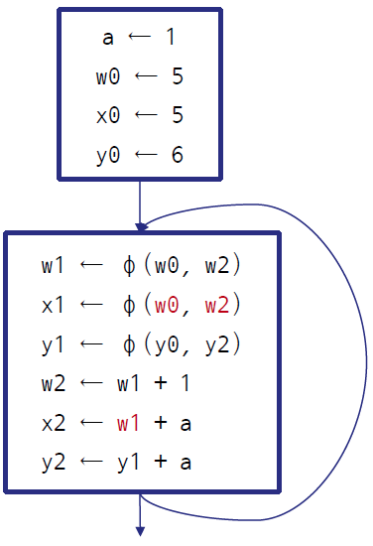
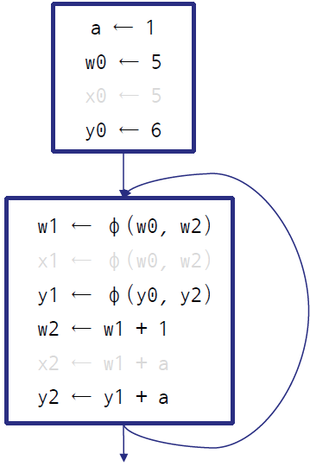
Value numbering
Eliminating Congruent Assignments
V1 is eliminated and replaced by V2 if
V1 and V2 are congruent
the assignment of V2 dominates the assignment of V1
Congruent assignment elimination
Dead code elimination

Slide 14
Benefits of SSA on Value numbering
Without φ-function, value numbering can only discover congruences in extended basic block
No information about the value of the predecessors can be propagated past a join point
W and X are congruent in the same arm
But Y is not found congruent to Z
Y and Z are now congruent

Slide 15
Benefits of SSA on Value numbering
Static single assignment never kill variables
Additionally, SSA gets rid of data flow analysis
Optimistic VN iterates over congruence classes
Pessimistic VN visits each assignment once
=> makes value numbering simple and effective
(1)
(2)
(3)
(2) Kills value computed by (1)
Y is not congruent with X
Y is now congruent with T

